Slide 1
Mobile Application Development
LECTURE #1
Cet 224 –SEB 312
Sidra Khatoon

Slide 2
Course Overview
This is 1+2 credit hour for CET and 2+1 credit hour for SET. In this course we will learn mobile application development on cross platform development framework such as Flutter. This course covers key principles, tools, and frameworks used to design and develop mobile applications for modern platforms. Students will gain hands-on experience in mobile UI/UX design, event-driven programming, database integration, and app deployment.

Slide 3
Course Learning Outcomes
CLO # | CLO Description
1 | Understand Mobile Application Development fundamentals and flow on multiple devices.
2 | Develop Mobile Applications using basic functionality, framework, and packages as a prototype.
3 | Build Mobile Application modules using software and hardware resources and evaluate their functionality.

Slide 4
Marks Distributions
Theory:
50 marks Final Term
20 marks Mid Term
10 marks Quizzes
20 marks Assignment and Project
Total Marks = 100
Lab:
30 marks Lab final
20 marks Lab sessional
Total Marks = 50

Slide 5
Course Project
Course project is assigned to apply taught concept of mobile application development with real world problem. You have to create a mobile application in your project.

Slide 6
Overview
What is Mobile Application Development
What are alternatives for building mobile apps
Comparison of native and hybrid apps
What is flutter?
Why Flutter?
How it is better than other Tools?
Benefits of flutter

Slide 7
Mobile Application Development
Mobile application development is the process of creating software applications that run on a mobile device, and a typical mobile application utilizes a network connection to work with remote computing resources.
Hence, the mobile development process involves creating installable software bundles (code, binaries, assets, etc.) , implementing backend services such as data access with an API, and testing the application on target devices.

Slide 8
Mobile Applications and Device Platforms
There are two dominant platforms in the modern smartphone market. One is the iOS platform from Apple Inc. The iOS platform is the operating system that powers Apple's popular line of iPhone smartphones. The second is Android from Google. The Android operating system is used not only by Google devices but also by many other OEMs to built their own smartphones and other smart devices.
Although there are some similarities between these two platforms when building applications, developing for iOS vs. developing for Android involves using different software development kits (SDKs) and different development toolchain.
Notes:
While Apple uses iOS exclusively for its own devices, Google makes Android available to other companies provided they meet specific requirements such as including certain Google applications on the devices they ship. Developers can build apps for hundreds of millions of devices by targeting both of these platforms.

Slide 9
Alternatives for Building Mobile Apps
There are four major development approaches when building mobile applications
Native Mobile Applications
Cross-Platform Native Mobile Applications
Hybrid Mobile Applications
Progressive Web Applications
Each of these approaches for developing mobile applications has its own set of advantages and disadvantages. When choosing the right development approach for their projects, developers consider the desired user experience, the computing resources and native features required by the app, the development budget, time targets, and resources available to maintain the app.

Slide 10
Comparing Native vs. Hybrid Applications
At the highest level, there are four main ways that native apps differ from hybrid apps as illustrated in the following table.
Native | Hybrid
Platform Specific | Cross Platform
Compiled Language | Scripting / Compiled
Access to Device Hardware | Plugins / Native Modules
Platform Frameworks | Web Frameworks

Slide 11
What is Flutter?
A “tool” that allows you to build native cross-platform (Android, iOS, Web, Desktop) applications one programming language and code base.

Slide 12
What is Native + Cross Platform?
A cross-platform computer product or system is a product or system that can work across multiple types of platforms or operating environments.
Cross platform is also know as multiplatform or platform independent.

Slide 13
Native vs Cross Platform vs Hybrid
Native: An application developed exclusively for single platform using a native-to-the-operating-system language is Native App.
Hybrid: A blend solution that consists of both native and web solutions. Developers embedded the code written with we development languages (HTML, CSS and JavaScript) into a native app using plugins Apache Cordova or Ionic's Capacitor.
Cross Platform: Write code once and reuse for different platforms.

Slide 14
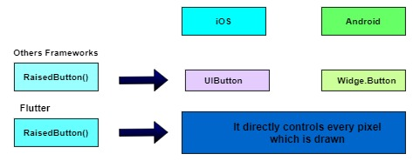
Flutter over other cross platforms

Slide 15
Benefits of Flutter
Increase time-to-market speed
Reduces code development time
The potential ability to go beyond mobile
Same UI and business logic in all platforms
Custom, animated UI of any complexity available
Similar to native app performance
Own rendering engine
Simple platform specific logic implementation

Slide 16
Flutter Architecture
The Layer Model: We'll explore the layers that make up Flutter, helping you understand how it's built.
Reactive User Interfaces: Learn about this key concept in Flutter UI development and how it makes your interfaces more dynamic.
Flutter Widgets: Get to know widgets, the core building blocks of any Flutter UI.
The Rendering Process: Understand how Flutter transforms your UI code into visuals on the screen.
Platform Embedders Overview: Discover how Flutter runs on different devices, including mobile and desktop.
Integrating Flutter with Other Code: We'll discuss the techniques for blending Flutter with existing codebases.
Support for the Web: Concluding with insights into Flutter's capabilities and performance in web applications.
Notes:
Widget tree means nesting. We have to build component tree. Means we have to build widget tree

Slide 17
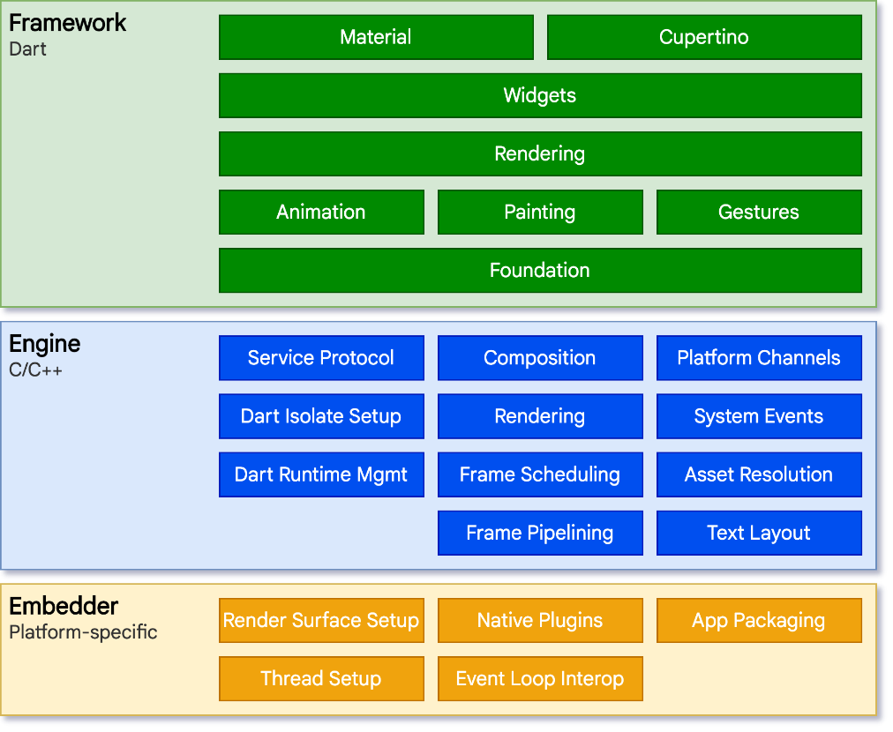
Flutter Layer Model
Notes:
Widget tree means nesting. We have to build component tree. Means we have to build widget tree

Slide 18
Flutter Layer Model (cont.)
The first layer is the Embedder. This is where Flutter connects with the device's operating system. Whether you're using an Android, iOS, Windows, or another type of device, the Embedder helps Flutter work with it
Above the Embedder is the Flutter Engine. Mostly written in C++, this engine is the heart of Flutter. It's responsible for important tasks like drawing images and text on the screen, handling files and internet connections, and running Dart code
Notes:
Widget tree means nesting. We have to build component tree. Means we have to build widget tree

Slide 19
Flutter Layer Model (cont.)
The Core Framework: Where Developers Work
Building Blocks
At the lowest level of the Framework, there are basic classes and services. These include things like animations, graphics, and ways to recognize user gestures.
Rendering Layer
Next up is the rendering layer. This is about arranging things on the screen. You create a tree of objects that can change dynamically, and Flutter updates the screen to show these changes.
Widgets Layer
Above that is the widgets layer. Widgets are the basic building blocks in Flutter apps. Each thing you see on the screen, like a button or a text field, is a widget. This layer lets you combine widgets to make more complex designs.
Material and Cupertino Libraries
Finally, there are the Material and Cupertino libraries. They provide ready-to-use widgets that follow specific design styles – Material for Android and Cupertino for iOS.
Packages: Expanding Flutter's Abilities
Beyond the core framework, Flutter can be extended with packages. These are additional tools and features created by the Flutter community. They cover a wide range of functionalities, from camera integration to web support.
Notes:
Widget tree means nesting. We have to build component tree. Means we have to build widget tree

Slide 20
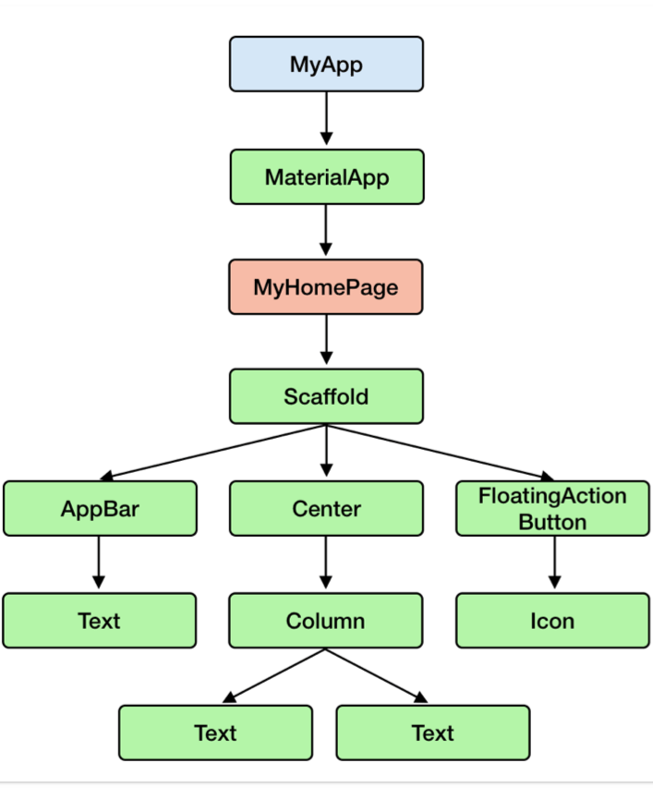
App formations

